Slide 1
Pure Financial Loss
Meora Teitler, ADV.
AIDA Europe Conference
Helsinki, June 2016

Slide 2
What is a pure financial loss?
Financial losses can be divided into two groups:
Consequential economic loss – a loss arising from a physical impact to the property or body of the claimant.
Pure financial loss- a non consequential loss.
It is the lack of connection between the physical damage to A caused by B and the following damage-the legitimate expectation of C ,D, E etc that makes it a pure financial loss.

Slide 3
Characteristics:
No damage to proprietary interests.
Financial damage that does not arise from nor is it an outcome of a physical damage or injury.
Damage to future financial interests ,deprivation of the chance for a profit.
An economic ricochet of a physical damage is a pure financial loss, suffered by a party as a result of a negligent act to the property or body of a third party.

Slide 4
Potential outcome
Broad scope of recognition may trigger the extension of tortuous liability, exceeding the borders of economical, moral and social issues, flooding courts with claims.
Judge Cardozo alerted against imposing unlimited liability in pure financial losses, describing it as "an indeterminate account for an indeterminate time to an indeterminate class“ . (Ultramares Corporation V. Touch, Niven& comp 174 N.E 441(N.Y 1931)179

Slide 5
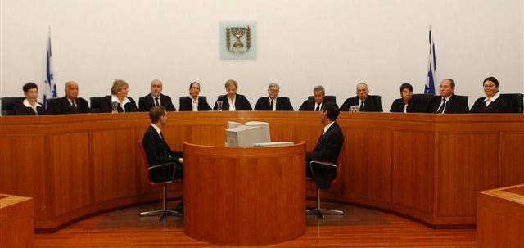
Step stones in Israeli court decisions
1954 Hm 106/54 Weinstein V. Kadima (PD 8 1317)
A negligent professional opinion given by an engineer who negligently designed a water tank for a local community.
The constructor relied on those designs that were not initially done for him.
The court ruled that the constructor’s reliance without an interim examination could not have been foreseen, therefore the engineer was not found liable in spite of his negligence.

Slide 6
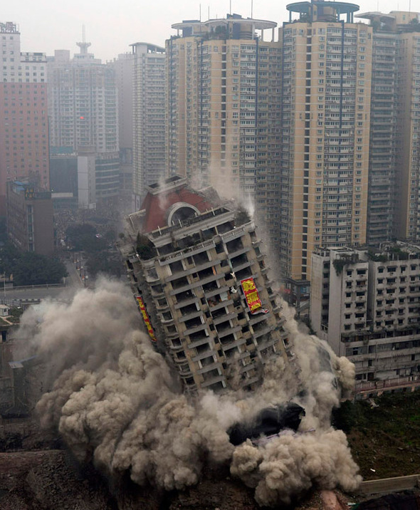
CA 5775/02 & CA 10717/04 Neveh Gan V. The Israeli Phoenix Insurance Company & others(2004/2006)
The plaintiff, a construction company, built a building that due to the surveyor's error, was built partially on the wrong plot and was required to demolish it and re-build it on the proper plot.
They sued the insurer of the "All risk contractors Policy".
The supreme court, determined that loss of value which is not accompanied to a physical damage cannot be considered a loss. The lack of physical damage- the cost of correction is a pure financial loss. Claim rejected.

Slide 7
CA 4493/05 Yerushalmi V Polaris (2007) :
The claimant was hurt during a motorbike race that took place in Egypt. He had been riding a bike imported by the defendant- Polaris, who did not advise him to buy insurance. There was no one to compensate him for his damages, both physical as well as financial.
He sued Polaris that also participated in the preparation for the race, but did not recommend any insurance.
The claim was rejected due to the lack of duty of care by Polaris.

Slide 8
CA3521/11 Wagner, Ayalon insurance company V Abadi, Leumi mortgage Bank, Discount Bank (2014)
Facts
In 1998 3 people approached adv. Wagner: An apartment broker: Barel (the buyer): Zvulun, Mrs. Abadi's son from her first marriage. They requested that Wagner will prepare a sale contract according to which Barel will purchase from Mr. &Mrs. Abadi the apartment, and also handle the request for tax exemption on their behalf.
On 5.7.98 Zvulun signed the sale agreement on behalf of the sellers according to an alleged notarized power of attorney, and Barel signed as the buyer.
Wagner notified Zvulun that the owners have to be present and declare in person when signing the request for tax exemption.
On 5.9.98 a couple that identified itself by an i.d as the Abadis signed the tax declaration.
In June 1998, before the signing of the contract, Barel approached Leumi Bank and requested a loan of N.I.S296,000 in order to fund the purchase of the apartment. He presented to the bank a sale contract and commitment letter allegedly signed by the Abadis and himself and allegedly verified by adv. Wagner.

Slide 9
CA3521/11 Wagner, Ayalon insurance company V Abadi, Leumi mortgage Bank, Discount Bank (2014)
Facts - continue
The loan proceeds were paid by Leumi in 2 cheques. The first in the amount of N.I.S 16,118 was paid to redeem a prior mortgage in another bank. The second cheque –a non transferable crossed cheque in favour of Mr.&Mrs Abadi , in the amount of N.I.S 279,882, as part of the proceeds for the apartment.
Wagner deposited the second cheque in a trust account he had opened in Octobre 1998 in the name of Mr. & Mrs Abadi in Discount bank through 2 powers of attorney allegedly signed by them.
On 21.10.98 Wagner withdrew the full amount deposited in cash. He gave N.I.S 278,740 in cash to an elderly couple that identified themselves through i.d as the Abadis. Later on it was discovered that they were imposters.
Barel did not repay the loan of Leumi and Leumi filed a third party notification against Barel, Zevulun, Discount Bank ,Wagner and Ayalon-the p.i insurer of Wagner.

Slide 10
CA3521/11 Wagner, Ayalon insurance company V Abadi, Leumi mortgage Bank, Discount Bank (2014)
Discussion
The appeal before the Supreme Court dealt with the issue of liability of adv. Wagner and Discount Bank towards Leumi.
None had a contractual relation with Leumi.
In such cases the scope of duty of care imposed on the damaging party is not unanimous and it changes according to circumstances.
The question before the Supreme Court was whether to impose tortuous liability on service renderers-the lawyer and Discount bank, for pure financial loss.

Slide 11
Adv. Wagner’s liability:
The delay in filing the tax report :
Does a lawyer have a duty not to be late in performing a service for a client towards the tax authority, in order to prevent damage to a third party?
the relation to the bank is indirect and far and does not justify imposing liability towards the bank in respect of the late reporting.

Slide 12
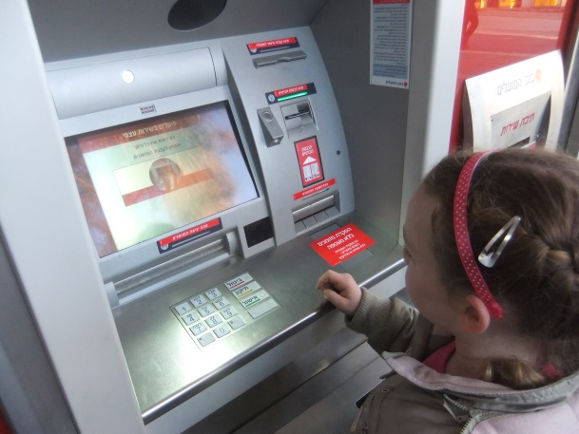
Adv.Wagner’s liability: continued
Deposit of the cheque and its redemption:
The duty of care towards a third party that is not its client is borderline and it has to pass three hurdles:
Reliance of the third party-the bank, regarding the cheque;
Forseeability- could Wagner have foreseen such reliance;
Causal nexus between his action and his relation with the bank.

Slide 13
Adv.Wagner’s liability: continued
Adv. Wagner should have ascertained that the proceeds of the cheque will be transferred to Abadi.
He owed Leumi a duty of care to deposit the cheque to the sellers account. He breached this duty by :
Depositing it to a trust account.
By withdrawing its proceeds in cash and giving it to imposters.
Had he given a cheque in favor of Abadi the foreseeable risk would not have materialized.
Therefore he was found liable with negligent conduct towards the bank.

Slide 14
Discount Bank’s liability:
Imposing a duty of care on the collecting bank towards the drawer coexists with the extension of banks duties towards third parties.
Discount Bank owes a duty of care towards Leumi Bank and acted negligently in agreeing to deposit the check drawn on Abadi to the trust account, thus aggravating the risk of Leumi.
Discount Bank should have foreseen such possibility.
There is a causal nexus between its negligence and the financial loss suffered by Leumi .

Slide 15
Conclusion
The common denominator of this group is the specific or implied liability to the party who alleges pure financial loss, coupled with the limited scope of possible injured parties.
The court will always use a checks and balances tests.
In general, courts are not inclined to impose liability towards the far circle of damaged parties. However, there are some exceptions.

Slide 16
Remedies to relatives
Article 78 to the Tort Ordinance, grants relief to the relatives (spouse, parents, and children) of a person deceased through a tort.
Article 5 to the Road Accident Damage Law grants relief to those who are dependent on the injured, even if the injured person itself is not entitled to it.
The dependency is limited to financial damages arising from the familial dependency, and does not spread to commercial dependency.

Slide 17
Emotional Damages
Alsouha case (RA 444/87 Alsouha V. Dahan’s Estate (PD 44 (3) 397).
A six year old child was badly injured in a car accident and 24 days later died. His parents had not been present at the time of the accident and arrived at the hospital immediately thereafter.
The suit, alleged mental/emotional anguish, depressions and incapability to work, all caused due to the trauma suffered by them.
This ruling set four aggregate conditions for the recognition of the secondary emotionally damaged person as eligible for compensation:
The identity of the claimant –closeness to the injured party .
Direct exposure to the traumatic event.
Scope of proximity of the damage (time and place).
Substance of damage – damage must be substantial.

Slide 18
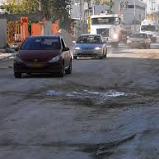
Current situation
Since then, courts extended its scope also to cases other then road accidents, and also to other, more distant relatives.
Courts also reduced the precondition of presence at the site and ruled that damage emanating far from the occurrence location and after some time or due to continuous exposure to the accident’s result may trigger liability.
(CA 3662 2/05 Estate of Shervin V. Eliyaho Insurance Company).

Slide 19
Reinsurers concerns
Pure financial loss is difficult to define and may have far reaching financial results if not applied prudently.
Different systems relate to the issue in a different manner.
The right of a third party-the damaged party, to sue the insurer directly may increase exposure.
Exclusionary wording must be specific and not vague.

Slide 20
Reinsurers concerns - continued
When monitoring a claim-always be updated with local state of the art legal situation.
Claim reserves should be based on cedants legal analysis.
Claims settlements should be reviewed according to cedants legal environment.

